Slide 1
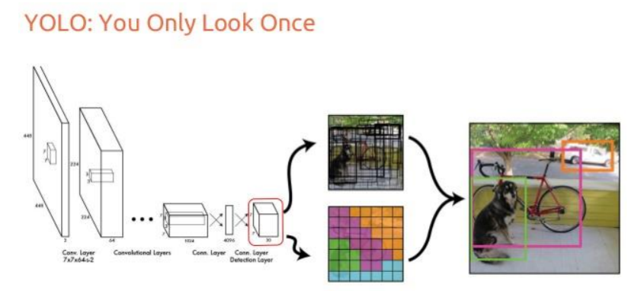
YOLO Model
Features extraction backbone
Bounding box regression + classes classification
Notes:
Afaq has started working on IRA 223 (Model training architecture)

Slide 2
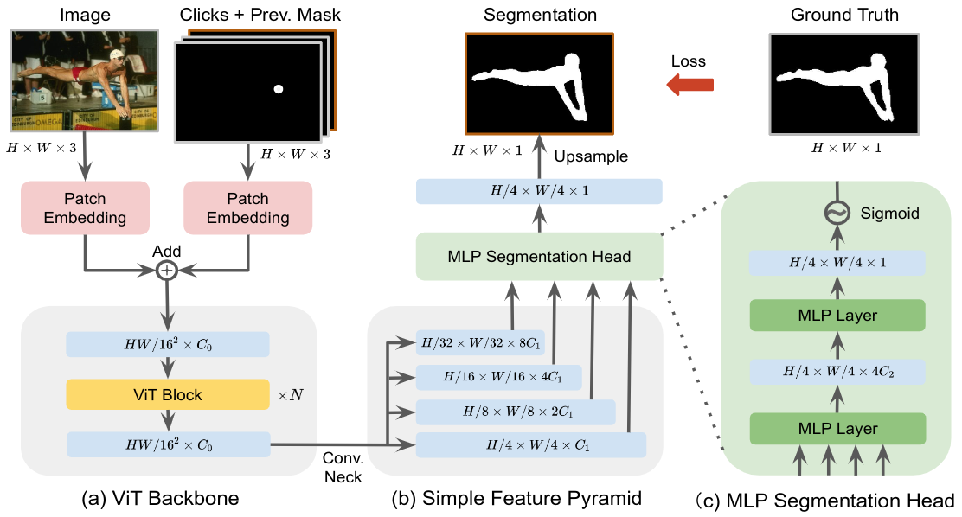
SimpleClick: Interactive Image Segmentation with Simple Vision Transformers
Vision Transformer for features extraction
FPN model for dense features extraction
MLP fully connected layers for segmentation
Notes:
Afaq has started working on IRA 223 (Model training architecture)

Slide 3
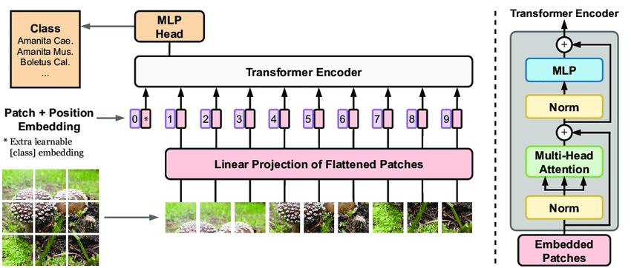
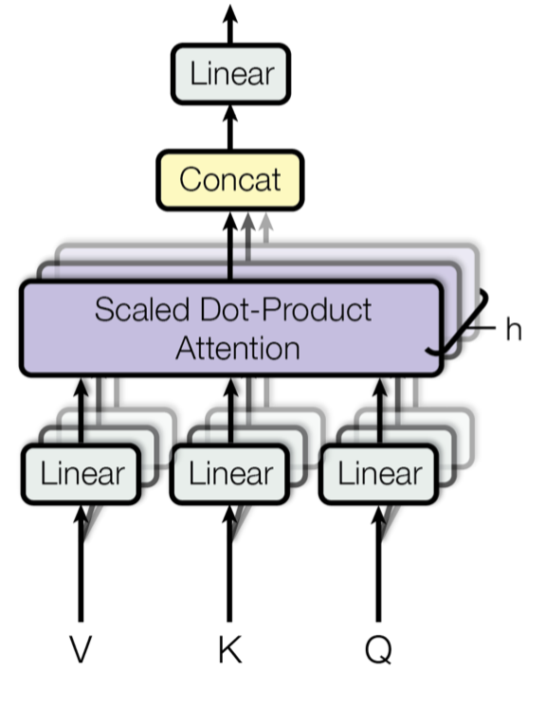
SimpleClick: Interactive Image Segmentation with Simple Vision Transformers
Vision Transformer for features extraction
Notes:
Afaq has started working on IRA 223 (Model training architecture)

Slide 4
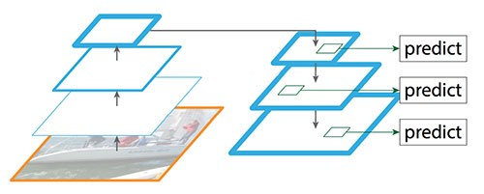
SimpleClick: Interactive Image Segmentation with Simple Vision Transformers
FPN model for dense features extraction
Notes:
Afaq has started working on IRA 223 (Model training architecture)

Slide 5
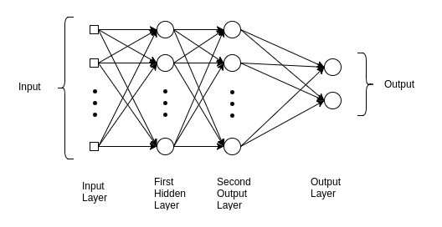
SimpleClick: Interactive Image Segmentation with Simple Vision Transformers
Multi-layer perceptron (MLP) fully connected layers for segmentation
Notes:
Afaq has started working on IRA 223 (Model training architecture)

Slide 6
SimpleClick: Interactive Image Segmentation with Simple Vision Transformers
Yolo prediction + SimpleClick Segmentation Colab Testing:
Add pretrained models shortcut in personal google drive
Upload and open Test_Complete.ipynb on google colab
Connect google colab to google drive.
Upload a testing image in colab.
Change the runtype to gpu in colab Runtime setting.
Enter the name of the image.
Run the 2nd last colab cell for image testing.
Notes:
Afaq has started working on IRA 223 (Model training architecture)

Slide 7
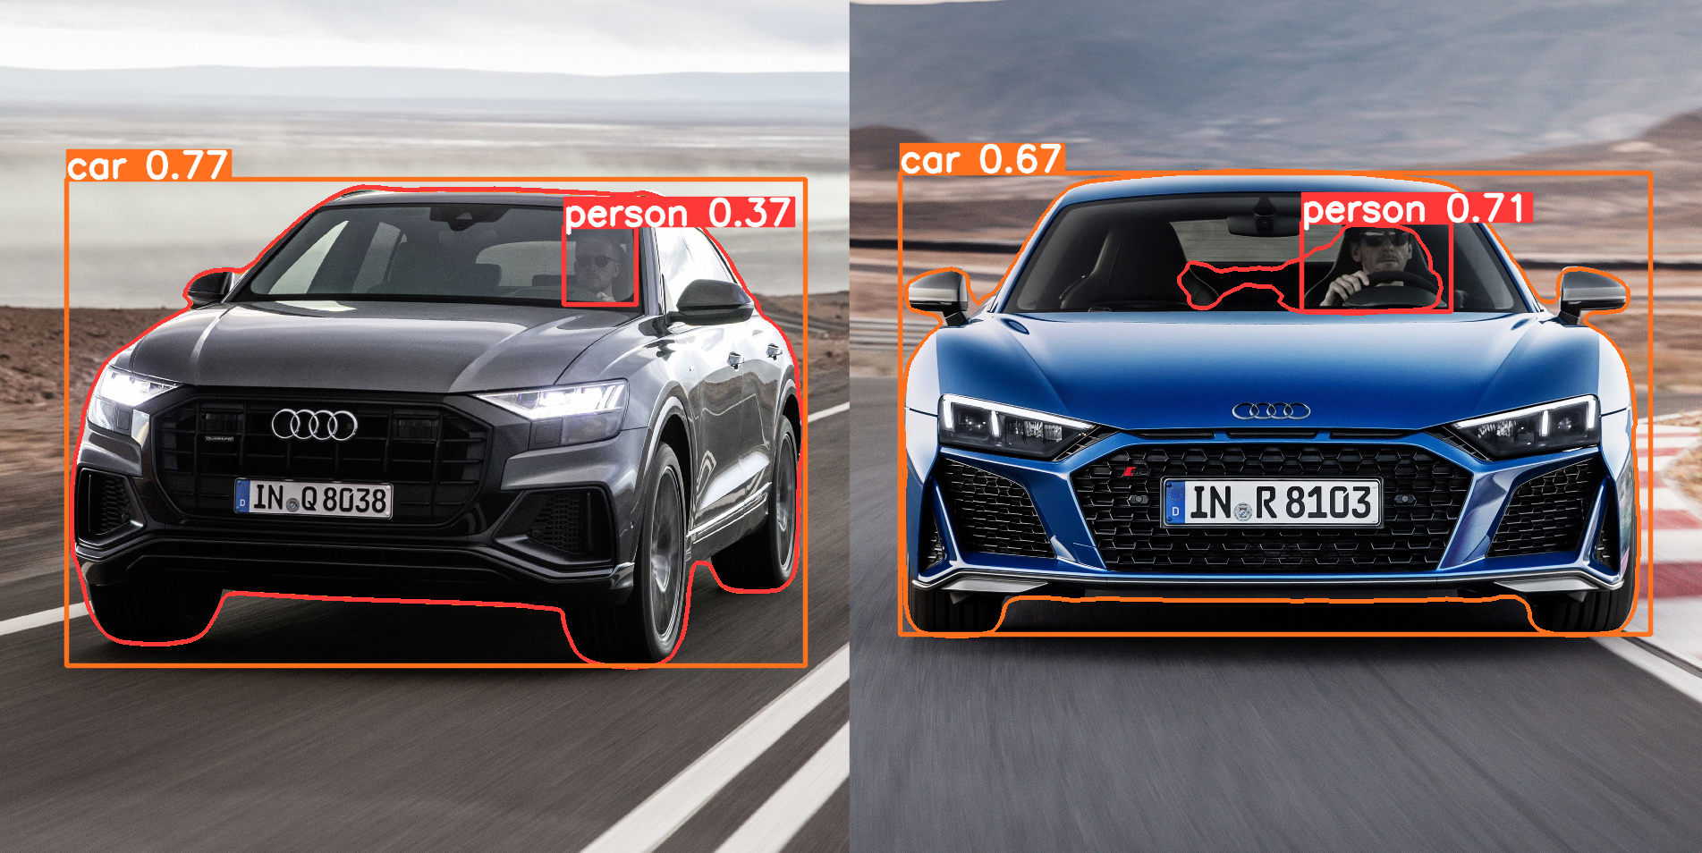
SimpleClick: Interactive Image Segmentation with Simple Vision Transformers
Yolo prediction + SimpleClick Segmentation
Simple click fails when object is inside of an object
Notes:
Afaq has started working on IRA 223 (Model training architecture)

